Slide 1
Slide 1
FEEDFORWARD APPROACH FOR DELIVERING FEEDBACK
Strategies, tips, and tools to effectively provide feedback and promote change
UB REds

Slide 2
Acknowledgements
No financial disclosures
Video content from Columbia College of Physicians and Surgeons Residents as Teachers website (http://resteach.ccnmtl.columbia.edu/)

Slide 3
Objectives:
Distinguish between feedback and feedforward design
Identify principles of effective feedback
Describe the Ask-Tell-Ask Method
Apply feedback techniques

Slide 4
Program Format:
Feedback Activity
Video review and discussion of feedback examples
Practice giving feedback

Slide 5
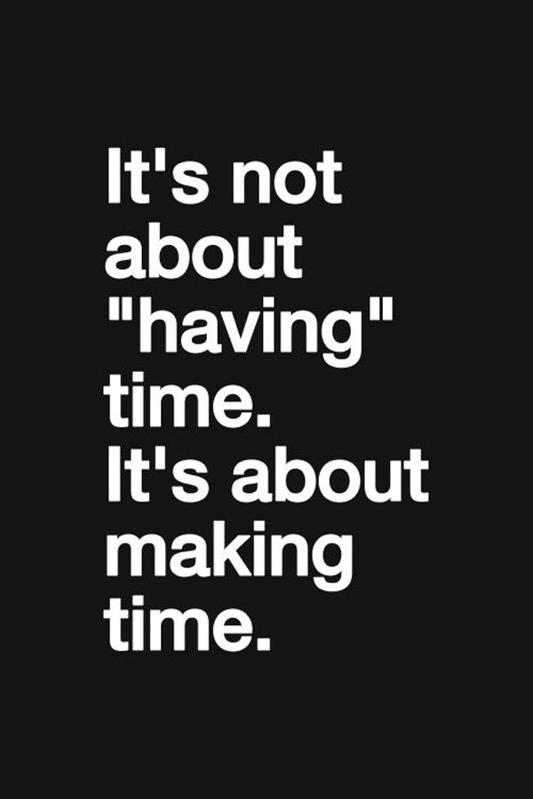
Slide 5
Notes:
Use this slide to provide direction for the session – we are all busy, there are many other things competing for our time.
Feedback takes time, yet, it is a critical component of learner growth and development.
Thus, we have to make the time to give feedback.
Plus, the more we give feedback, the better we get at it and the easier it becomes to incorporate into our relationship with learners.

Slide 6
Feedback Activity
Notes:
Instructions for activity on subsequent slide

Slide 7
Slide 7
What’s the main reason why you don’t give feedback more often?
How do you typically react when receiving feedback?
What’s the main reason why you don’t solicit feedback more often?
Notes:
Materials: 3x5 index cards (one for each participant)
1. Make sure every participant has a 3x5 index card.
2. On the blank side of the card, direct the participants to divide the card into 3 sections using a pen or pencil.
3. In the top section, direct each participant to answer the question, “What’s the main reason you do not give feedback more often?” Give them about 30 seconds – 1 minute.
4. In the middle section, direct each participant to answer the question, “How do you react when you receive feedback?” Give them about 30 seconds – 1 minute.
5. In the bottom section, direct each participant to answer the question, “What’s the main reason you do not solicit feedback more often?” Give them about 30 seconds – 1 minute.
6. After everyone has completed their card, have them exchange cards with someone in the group. If the group doesn’t know each other, have them also introduce themselves and identify what their role/job/specialty is.
7. After everyone has exchanged cards, have them exchange cards a second time with someone else but make sure they do not get their original card back. Again, make introductions if applicable.
8. Tell the participants that they should have a card with no emotional or personal attachment, so that it will be easy for them to read what’s on the card. Restate each question (see #3, 4 & 5 above) and have participants read the responses. For example, after you read the first question, have several people read what’s on their card. See if others have the same response. Ask for any different responses. From my workshops, the number one response is ‘time related’ (no time, too busy, etc.). The number two response is ‘reaction of the receiver’ (don’t know how they will take it, afraid of response, etc.).
9. For the responses to the second question (how do you react…), try to see if the participants are more positive or negative in their responses. Some groups see it as useful, helpful, consider it and use it. Other groups see it as scary, afraid, don’t want to know or not helpful.
10. For the third question (soliciting…), the number one response from my workshops was time related. The number two response was worried about what they will hear.
11. Use the responses to generate brief discussions about any response or reaction.

Slide 8
“It’s Just Not The Culture…”
Resident Perceptions of the Impact of Institutional Culture on Feedback:
Lack of clear expectations
Prevailing culture of niceness hinders ability to deliver honest feedback
No bidirectional feedback
Faculty-resident relationships impact credibility and receptiveness to feedback
There is a need to establish a culture of longitudinal professional growth
Competency-based medical education requires ongoing performance-based feedback for professional growth.
Ramani et al. “It’s Just Not the Culture.” Teach Learn Med. 2016 Dec 21:1-9
Notes:
Use this slide and the reference below to discuss the importance of creating a supportive learning environment that encourages ongoing collaborative feedback.
Teach Learn Med. 2017 Apr-Jun;29(2):153-161. doi: 10.1080/10401334.2016.1244014. Epub 2016 Dec 21.
"It's Just Not the Culture": A Qualitative Study Exploring Residents' Perceptions of the Impact of Institutional Culture on Feedback.
Ramani S¹, Post SE¹, Könings K², Mann K³, Katz JT¹, van der Vleuten C².
Author information
Abstract
Phenomenon: Competency-based medical education requires ongoing performance-based feedback for professional growth. In several studies, medical trainees report that the quality of faculty feedback is inadequate. Sociocultural barriers to feedback exchanges are further amplified in graduate and postgraduate medical education settings, where trainees serve as frontline providers of patient care. Factors that affect institutional feedback culture, enhance feedback seeking, acceptance, and bidirectional feedback warrant further exploration in these settings.
APPROACH:
Using a constructivist grounded theory approach, we sought to examine residents' perspectives on institutional factors that affect the quality of feedback, factors that influence receptivity to feedback, and quality and impact of faculty feedback. Four focus group discussions were conducted, with two investigators present at each. One facilitated the discussion, and the other observed the interactions and took field notes. We audiotaped and transcribed the discussions, and performed a thematic analysis. Measures to ensure rigor included thick descriptions, independent coding by two investigators, and attention to reflexivity.
FINDINGS:
We identified five key themes, dominated by resident perceptions regarding the influence of institutional feedback culture. The theme labels are taken from direct participant quotes: (a) the cultural norm lacks clear expectations and messages around feedback, (b) the prevailing culture of niceness does not facilitate honest feedback, (c) bidirectional feedback is not part of the culture, (d) faculty-resident relationships impact credibility and receptivity to feedback, and (e) there is a need to establish a culture of longitudinal professional growth. Insights: Institutional culture could play a key role in influencing the quality, credibility, and acceptability of feedback. A polite culture promotes a positive learning environment but can be a barrier to honest feedback. Feedback initiatives focusing solely on techniques of feedback giving may not enhance meaningful feedback. Further research on factors that promote feedback seeking, receptivity to constructive feedback, and bidirectional feedback would provide valuable insights

Slide 9
slide 9
Have you set expectations for your learner?
Have you engaged your learner by asking about their learning goals?
Engage
Enhance
Does your teaching focus on learner needs?
Does your feedback provide the learner with opportunity to grow?
Extend
Notes:
How do we create a supportive feedback culture – it starts with the learner: getting to know the learner, setting up the learner for success (can only achieve the goals/expectations that you set/communicate)
Need to know learner goals/observe performance firsthand to deliver effective feedback
Agreement of goals promotes teamwork and ownership of learning by learner, increases learner motivation and productivity
Individualized learning goals lead to more efficient and effective teaching
Useful feedback to improve performance is aligned with learner goals and is based on observation

Slide 10
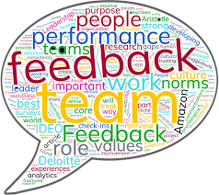
Why Feedback?
“Without feedback, mistakes go uncorrected, good
performance is not reinforced, and clinical competence is
achieved empirically or not at all.”
“The important things to remember about feedback in
medical education are that (1) it is necessary, (2) it is
valuable, and (3) after a bit of practice and planning, it is not as difficult as one might think.”
- Jack Ende
Ende J. Feedback in Clinical Medical Education. JAMA 250(6):777-81, 1983
Notes:
“Jack Ende - the “father of feedback” in medical education -wrote this often referred-to JAMA article on feedback in 1983.”

Slide 11
Why Feedforward?
We can change the future. We can’t change the past.
Helping a trainee learn to be right is more productive than proving they were wrong.
It is not taken as personally as feedback.
It reinforces the possibility of change.
Goldsmith, M. Feedforward.2012.
Notes:
We can change the future. We can’t change the past. Feedforward helps people envision and focus on a positive future, not a failed past. By giving people ideas on how they can be even more successful (as opposed to visualizing a failed past), we can increase their chances of achieving this success in the future.
It can be more productive to help people learn to be “right,” than prove they were “wrong.” Negative feedback often becomes an exercise in “let me prove you were wrong.” Feedforward, on the other hand, is almost always seen as positive because it focuses on solutions - not problems.
People do not take feedforward as personally as feedback. In theory, constructive feedback is supposed to “focus on the performance, not the person”. In practice, almost all feedback is taken personally (no matter how it is delivered). Feedforward cannot involve a personal critique, since it is discussing something that has not yet happened!

Slide 12
Slide 12
Notes:
In brief – Feedforward is positive suggestions for the future
Feeding forward puts an emphasis on what to do next and on how to get better. It offers suggestions on what to do next time. The emphasis is on strategies, behaviors and processes and not just on past outcome or current level. Whereas with feedback, the teacher does most of the work. With feeding forward, you get the students to think about what they need to do. You get them focused on moving forward.

Slide 13
Principles of Effective Feedback
Timely
Specific
Linked to goals/objectives/competencies
Suggests correct performance
Focused
Balanced
Expected
Frequent
Includes a programmed plan for follow-up
Notes:
This is an animated slide, consider asking – What are important components to consider when giving feedback? Then, reveal list.

Slide 14
Delivering Feedback Effectively
S Specific
O Objective
M Modifiable Behaviors
E Expected
T Timely
L Limited
C Constructive
SOME
TLC
Burket, J. The Need to Feed(back). Madigan Faculty Development Fellowship. AAFP
Notes:
Mnemonic to share for important components to consider when giving feedback

Slide 15
Ask-Tell-Ask
ASK
TELL
ASK
Learner to self-assess
Reinforce correct thinking
Learner to develop an action plan
Comment on specific actions/behaviors amenable to change
Suggest modifications for the future
Notes:
Learner-centered model for giving feedback
Active/interactive discussion, includes learner’s perspective
Reflection may make it easier to separate the behavior from the person
Avoids assumptions or judgement
If this is corrective feedback (i.e. inappropriate behavior, performance violation)…a few considerations:
Think it through first, manage your emotions and anticipate the learner’s reaction
Allow the learner to tell his/her side of the story
Devise an improvement plan

Slide 16
Ask-Tell-Ask Expanded
Ask
Tell/
Teach
Act
Ask
Feedback Dialogue
Notes:
Includes Teach and Act

Slide 17
Ask
Ask learner to assess their own performance
How do you think you did?
What do you think went well?
Did you have any problems?
Would you have done anything different?

Slide 18
Tell/Teach
Tell
I observed
It seems as though…
When you do ___ I feel ___ …
Teach (short pearls)
In my experience…
Consider…

Slide 19
Ask
Ask learner to reflect and analyze
What do you think of…
my observations?
my comments?
What would you do differently?
What can we do to improve?

Slide 20
Act
Summarize key points
Demonstrate
Re-assess
Commit to a plan

Slide 21
Delivering Feedback Effectively
Notes:
Columbia College of Physicians & Surgeons Residents as Teachers website
http://resteach.ccnmtl.columbia.edu/mod03/
Scroll down page to Videos:
Play Microskill 4&5 bad & good– giving feedback- show both video examples (link for the bad example only works under “apple” video column)
Play bad video first, then good video. After each video, have participants pair/share and then debrief as large group what was observed, what worked/what did not work.

Slide 22
Slide 22
Notes:
Materials:
Use handout on Feedback Scenarios for role play activity.
Break into groups of 2-3 – assign a learner, teacher, +/- observer.
Practice giving feedback using Ask-Tell-Ask model.

Slide 23
Key Points
Establish a culture of regular feedback to promote learner growth
Craft your feedback conversation using a feedforward approach
Give SOME-TLC via Ask-Tell-Ask-Act

